Slide 1




Data Engineering mini Bootcamp:Python Web Scraper for Automotif Market intelligence in Indonesia
By Ahmad Farichin

Slide 2
Table of contents
Web Scraping
01
Project Overview
02
Visualisation
03
Data Cleansing
04

Slide 3


01
Project Overview

Slide 4


web scraping from the carmudi website
This project involves building a Python-based web scraper to collect used car data from Carmudi.co.id. The scraper automatically extracts key information such as brand, model, price, year, location, and mileage.
It uses the requests, BeautifulSoup, and pandas libraries to fetch, parse, and clean the data. After scraping, a data cleansing step ensures the dataset is clean and ready for analysis or further application use.

Slide 5
02
Web scraping

Slide 6
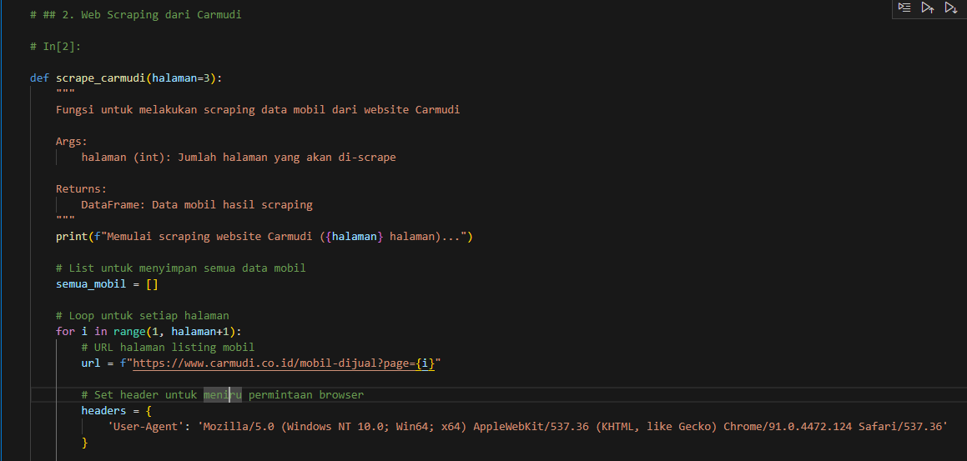
Code data scraping with BeautifulSoup

Slide 7
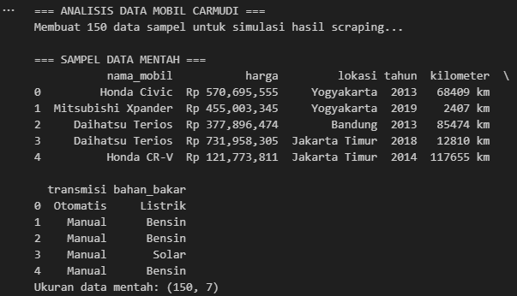
raw data successfully scraped

Slide 8
03
Data Cleansing

Slide 9
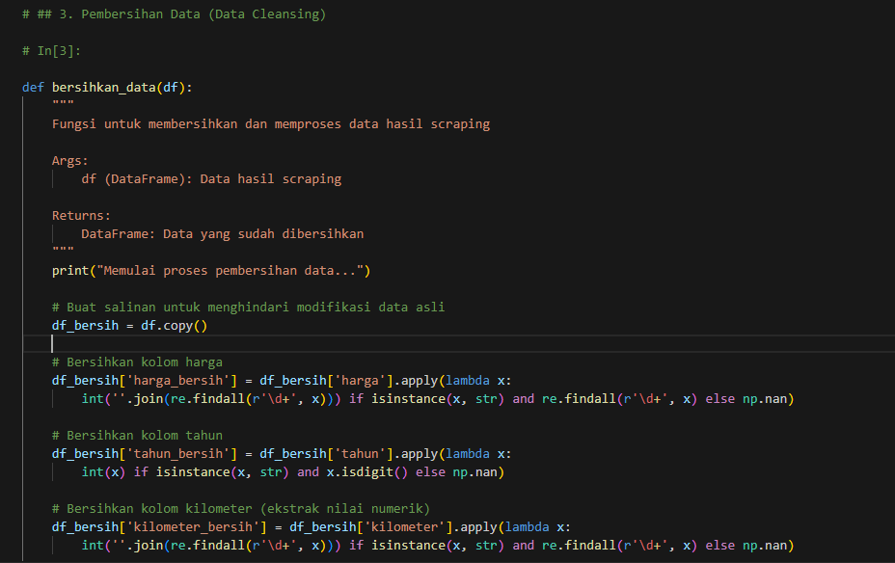
Code of data cleansing

Slide 10
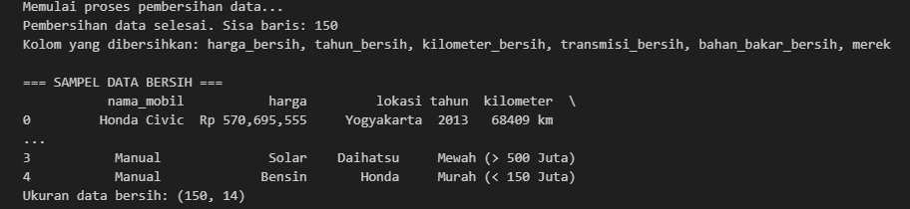
Data successfully cleaned

Slide 11
04
visualisation

Slide 12
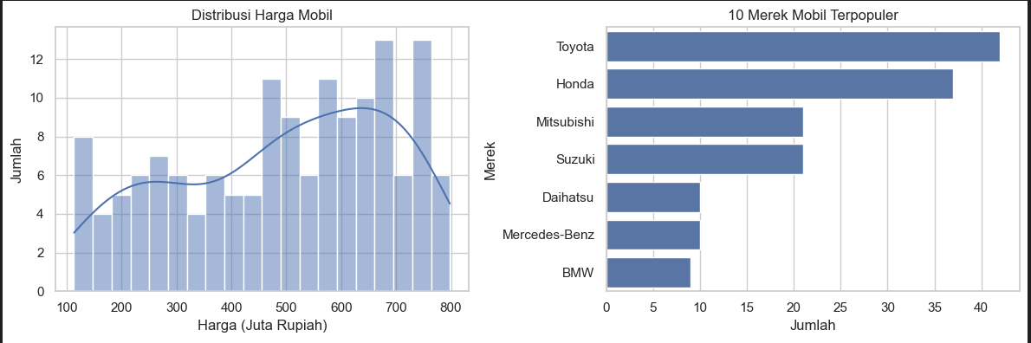
car price distribution 10 most popular car brands

Slide 13
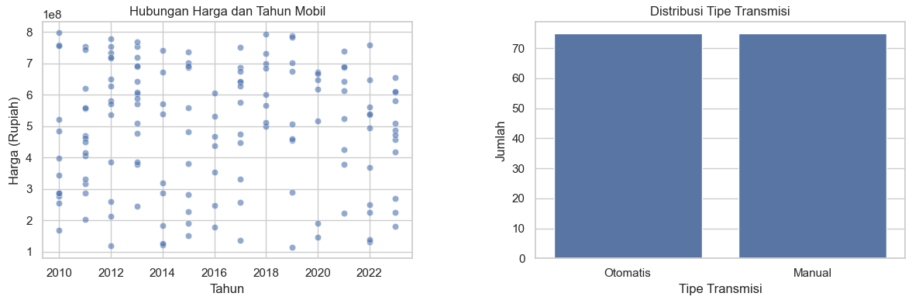
relationship between price and year of car distribution of transmission type

Slide 14
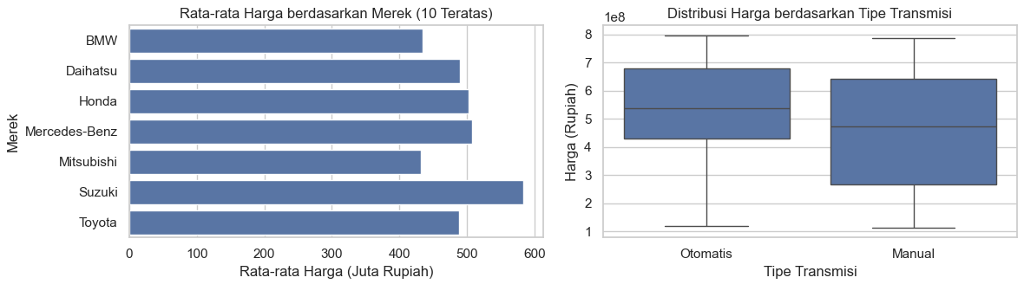
average price by brand price distribution based on transmission type

Slide 15
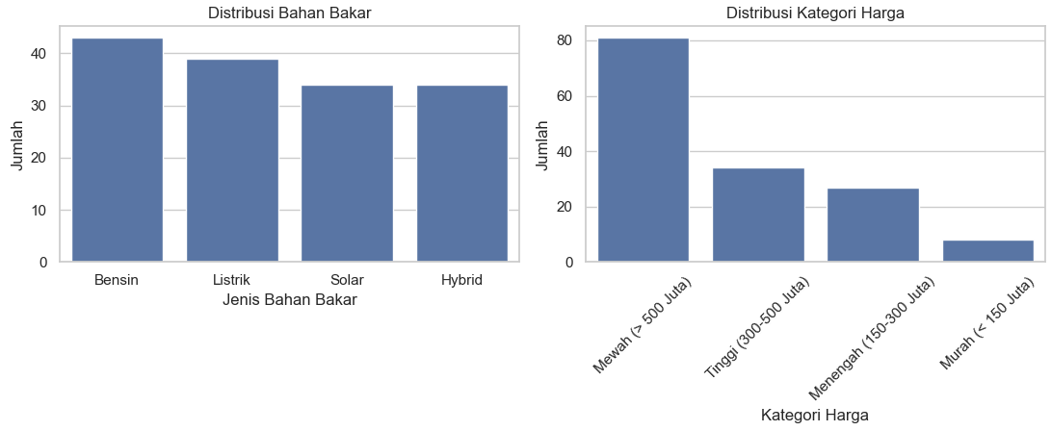
fuel distribution distribution of price categories

Slide 16
conclusion
Car Prices: Most cars fall into the low to mid-price range.
Top Brands: 10 brands dominate the listings, indicating market preference.
Price vs Year: Newer cars tend to have higher prices.
Transmission: One transmission type (manual or automatic) is more common.
Average Price by Brand: Some brands have higher average prices, reflecting premium segments.
Price by Transmission: Automatic cars are generally more expensive than manual ones.
Fuel Type: Gasoline-powered cars are the most common, followed by diesel and others.
Price Category: Mid-range priced cars are the most available.

Slide 17
thank you

